Slide 1



OLIST · DATA-DRIVEN GROWTH INITIATIVE
Strategic Retention:
Precision Segmentation & Logistic Optimization
Machine-learning customer segmentation that replaces rule-based RFMS with a deployable K-Means pipeline, translating customer spending, delivery experience, and satisfaction into targeted retention strategies.
Fauzan Hanindyawan Yusnidzar
BI Analyst · July 2026
Canly Hansen Sudirman
Data Scientist · July 2026

Slide 2




Table of Content
Business Understanding
01
Understand how Olist creates value, who owns the business problem, and what data supports the analysis.
Problem Diagnosis
02
Identify why growth is stagnating and which customer-experience factors are associated with retention risk.
Business Solution
03
Move from rule-based RFMS to data-driven clustering and uncover actionable customer profiles.
Strategic Recommendations
04
Translate customer profiles into targeted actions, implementation priorities, and measurable business impact.
02

Slide 3
Business Understanding
Chapter 01
Company Overview
Olist Generates Revenue by Enabling and Scaling Marketplace Transactions
olist
What is Olist?
Olist is a Brazilian e-commerce technology company operating as a Marketplace Integrator (SaaS + Marketplace model). It connects small and medium-sized businesses (UKMs/SMEs) to Brazil's largest e-commerce marketplaces — Mercado Livre, Americanas, Shoptime, and Submarino — through a single, centralized platform.
Brazilian E-Commerce Platform
Founded:
2015, Curitiba, Brazil
Model:
Marketplace Integrator (B2B2C)
Sector:
E-commerce / SaaS
Revenue Generation Model
Presence:
Pan-Brazil, 27 states
💰 Monthly SaaS subscription fees from sellers
📦 Commission per transaction (% of GMV)
Data Period:
January 2017 – August 2018
🚚 Logistics service fees
Revenue Source:
Commission + SaaS Fees
📊 Premium analytics & seller tools upsell
03

Slide 4
Business Understanding
Chapter 01
Organization Structure
CEO / Founder
Product &
Technology
Commercial &
Sales
Operations &
Logistics
Marketing &
Growth
Engineering
Data
Science
Seller Acq.
Logistics
CS
& Support
Performance
Brand
UX
/Design
Key Accounts
Partnerships
Seller
Ops
CRM
Cross-Functional Teams
Primary stakeholder: Operations & Logistics, Secondary stakeholder: Marketing & Growth
04

Slide 5
Business Understanding
Chapter 01
Data Understanding
Order level dataframe
• order_purchase_timestamp — Purchase date-time
• customer_state / customer_state_desc — Customer location
• order_delivered_customer_date — Actual delivery date
• seller_state — Seller location
~94,751 rows
• total_products / total_price / total_freight — Order financials
• jarak_km — Distance customer ↔ seller (Haversine)
Master order-level dataset after cleaning & merging.
• payment_value — Total amount paid (price + freight)
Customer level dataframe
• customer_unique_id — Unique customer key
• segment — RFMS segment label (10 segments)
• recency — Days since last purchase
• at_risk_flag — at-risk / not-risk label
~91,709 rows (customer-level)
• frequency — Total number of orders
• customer_late_status — late_victims / not_late_victims
Customer-level RFMS dataset. One row per unique customer.
• payment_value — Total lifetime spending
• avg_jarak_km — Average delivery distance
• mean_review_score — Avg satisfaction score
• delivery_time_days — Avg delivery duration
Item level dataframe
• order_id — Links to order dataset
• freight_value — Shipping cost for item
• product_id — Product identifier
• product_category_name — Category in Portuguese
~108,489 rows (item-level)
• review_score — Merged from reviews dataset
• seller_id — Seller identifier
Raw item-level dataset — one row per product per order.
• price — Product price (BRL)
05

Slide 6
Problem Diagnosis
Chapter 02
Problem 1: Olist Scaled Rapidly, but Customer Retention Did Not
Summary
Stagnate growth in 2018
91,709
Significant peak in November 2017 due to seasonality effect
customers analyzed
94,751
orders 2017–2018
Revenue grew approximately 8× through 2017-2018
R$15.1M
observed revenue
3.00 %
Repeated Order
Jan 2017 – Aug 2018
To understand who was not returning and how their experiences differed, we first used RFMS as a diagnostic segmentation framework.
06

Slide 7
Problem Diagnosis
Chapter 02
RFMS Provides the First Diagnostic View of Customer Risk
RFMS Framework: Recency (1-5) × Frequency (1-3) × Monetary (1-5) × Satisfaction (1-5)
#
Segment
Status
Action Plan
Scoring Info
🏆
Champions
Non-Risk
VIP program + Brand ambassador
R: 4-5, F: 2-3, M: 4-5, **S: 4-5**
🤝
Loyal Customers
Non-Risk
Up-sell & cross-sell campaigns
R: 3-5, F: 2-3, M: 1-5, **S: 3-5**
✨
Recent Buyers / New
Non-Risk ★ Largest
2nd purchase voucher (30-day)
R: 4-5, F: 1, M: 1-5, **S: 4-5**
⚡
Potential Loyalists
Non-Risk
R: 3, F: 2-3, M: Any, **S: 4-5**
Personalized push notification
💤
About to Sleep
AT RISK
R: 2-3, F: 1, M: Any, **S: 4-5**
Limited-time re-engagement offer
🌑
Lost / Hibernating
AT RISK
Mass reactivation campaign
R: 1, F: 1, M: Any, **S: 3-5**
📉
Hiatus Customers
AT RISK
Low-cost reactivation drip
R: 1-2, F: 2-3, M: 3-5, **S: 3-5**
⚠️
Can't Lose Them
AT RISK
Win-back premium offer
R: 1-2, F: 2-3, M: 4-5, **S: 3-5**
🚨
Critical / Frustrated
AT RISK
CS proactive intervention
R: Any, F: 2-3, M: Any, **S: 1-2**
💔
Bad First Impression
AT RISK
Apology + compensation voucher
R: Any, F: 1, M: Any, **S: 1-2**
Hosseini, S. M., Maleki, A., & Gholamian, M. R. (2010). "Cluster analysis using data mining approach to develop customer profiles to change the business strategy." Expert Systems with Applications, 37(7), 5252-5259 (https://doi.org/10.1016/j.eswa.2009.12.070)
07

Slide 8
Problem Diagnosis
Chapter 02
RFMS Customer Segmentation Profile
Revenue Contribution by Segment
💡
Key Insight: RFMS segmentation reveals that Recent Buyers / New Customers is the largest segment (~40K customers), yet most are classified as churn-risk due to low recency scores after initial purchase. Champions and Loyal Customers represent only ~8% of the base but generate disproportionately high revenue per customer — the monetization gap is stark. We still need to validate whether these manually defined segments are statistically meaningful.
08

Slide 9
Problem Diagnosis
Chapter 02
Problem 2: Logistics & Delivery Reliability
Delivery Time Matters
At Risk Rate by Late Delivery Status
13.6 days
At-risk customers avg delivery
22.7
77.3
80
9.5 days
Late victim
LATE / AT RISK
Not risk avg delivery
LATE / NOT RISK
60
62.8
37.2
💡 Key Insight:
Not a late victim
ON-TIME / AT RISK
40
ON-TIME / NOT RISK
Late deliveries have a severe compounding effect on churn-risk. Customers who experience even one late delivery are 77% at risk of churn vs. 63% for on-time recipients — a 14-percentage-point gap. This is the single highest-impact operational metric tied directly to revenue retention.
20
Not Risk
At Risk
ON-TIME / CHURN RISK
09

Slide 10
Problem Diagnosis
Chapter 02
Problem 2: Logistics & Delivery Reliability
Distance Group | Distance Range
Very close | 0.05 km to 117.03 km
Close | 117.03 km to 347.23 km
Moderate | 347.23 km to 525.58 km
Far | 525.58 km to 873.86 km
Very Far | 873.86 km to 3399.19 km
💡 Key Insight:
Customers ordering from distant sellers belongs to at-risk group 68% vs. 58% for customers with short-distance orders. The at-risk share increases consistently across distance bands, suggesting that longer fulfilment routes may contribute to weaker customer experiences.
10

Slide 11
Problem Diagnosis
Chapter 02
Problem 3: Inconsistent Customer Satisfaction
Satisfaction Drives Loyalty
At-Risk Proportion compared to Last Review Statement
4.60
Not Risk avg review score
3.91
At-risk avg review score
💡 Key Insight:
Sentiment analysis of reviews reveals that 1-star reviews are dominated by keywords: 'atraso' (delay), 'não chegou' (did not arrive), and 'produto errado' (wrong product). Negative reviews are primarily associated with fulfilment failures, including delays, non-arrival and incorrect items..
11

Slide 12
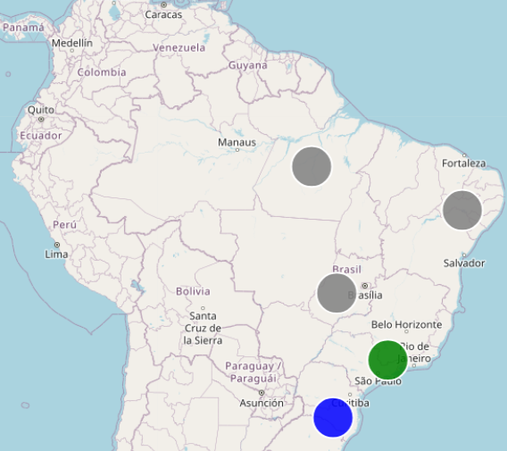
Problem Diagnosis
Chapter 02
Problem 4: Geographic Revenue Concentration
80%+
💡Key Insight :
Revenue is highly centralized, with the Southeast alone contributing 71% of the total share. This is anchored by São Paulo (R$ 5Mio) and Rio de Janeiro (R$ 2Mio) as the nation's core business powerhouses. Revenue is concentrated in the Southeast, while longer routes are associated with higher risk. This suggests a potential fulfilment coverage gap outside Olist’s core commercial region
12

Slide 13




Problem Diagnosis
Chapter 02
Summary
❓ "Why do 97.0% of Olist customers never return after their first purchase, and how can we reverse this trend to maximize revenue?"
Problem 1: Olist Scaled Rapidly, but Customer Retention Did Not
Problem 2: Logistics & Delivery Reliability
97% of customers are one-time buyers. Only 3% (2,745 out of 91K unique customers) made a repeat purchase — signaling a critical retention failure.
~8% of orders arrive late. At Risk among late delivery victims reaches 77% vs. 63% for on-time deliveries. Average delivery time for at-risk customers: 13.6 days vs. 9.5 days.
Problem 3: Inconsistent Customer Satisfaction
Problem 4: Geographic Revenue Concentration
Review scores are bimodal: 57K customers give 5-star reviews, but 11K give 1-star. Churn-risk customers average only 3.91 stars vs. 4.60 for loyal customers.
Around 71% of revenue originates from Southeast Brazil (São Paulo, Rio de Janeiro, Minas Gerais). North and Northeast markets remain highly underserved.
13

Slide 14
Business Solution
Chapter 03
Move Beyond Rule-Based RFMS
RFMS was useful as a first diagnostic lens, but fixed thresholds produced overlapping segments that were difficult to scale into customer activation.
STEP 1
GAP
STEP 2
What RFMS gave us
Where RFMS falls short
What ML must deliver
• Interpretable risk labels
• Initial at-risk vs. not-risk lens
• Threshold-based boundaries
• Low silhouette score: 0.036
• Data-driven segment boundaries
• Stronger statistical separation
• Business interpretability
Transition logic
Diagnostic rules → data-driven clustering → actionable customer profiles
14

Slide 15
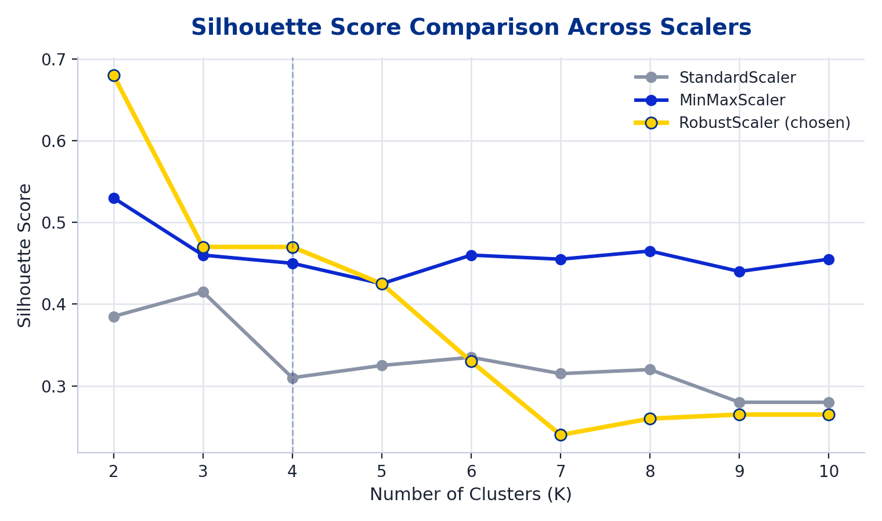
Business Solution
Chapter 03
Feature Engineering: Choosing the best scaler (Robust Scaler)
Because the model used is K-Means and DBSCAN, the data must be scaled first. We compared three scaling methods: Robust Scaler, MinMaxScaler, and Standard Scaler.
KEY INSIGHT
Robust Scaler wins
K = 4 • Silhouette ≈ 0.472
It delivers the most stable cluster separation, outperforming other scalers.
Although K=2 produced the highest silhouette score, it divided customers into groups that were too broad for differentiated business action. K=4 was selected as the best balance between separation, interpretability and strategic usability.
15

Slide 16
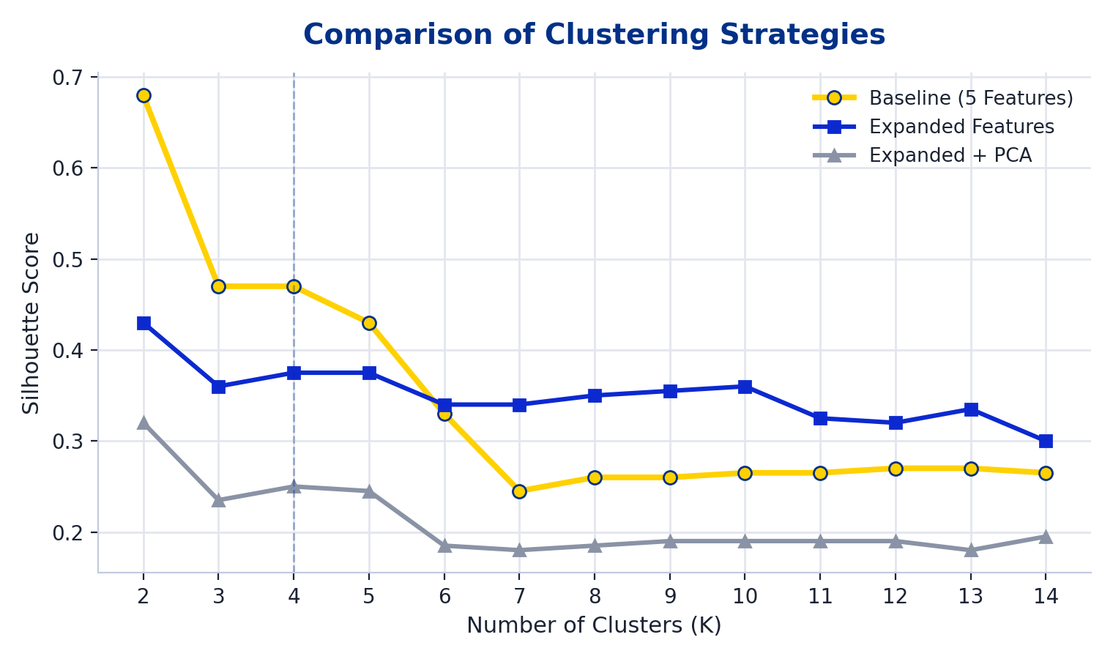
Business Solution
Chapter 03
Feature Engineering: Choosing the best feature set (Baseline)
BASELINE (5)
EXPANDED (11)
EXPANDED + PCA (3)
Recency
Frequency
Payment Value
Mean Review Score
Delivery Days
BASELINE
Mean distance
Month encoded (OHE)
Customer state (binary enc.)
Late-victim status (OHE)
Distance flag (OHE)
Latest review flag (OHE)
PCA1
PCA2
PCA3
(dimensionality-reduced from the 11 expanded features)
KEY INSIGHT
Adding more engineered features or PCA does not help. The 5-feature baseline set keeps the strongest, most interpretable separation at K=4.
16

Slide 17
Business Solution
Chapter 03
Model Benchmarking: K-Means Baseline is chosen
Model | Segments | Silhouette | Interpretability | Verdict
RFMS | 9 | 0.036 | High | Too noisy, statistically weak.
DBSCAN | 26 (+Noise) | 0.086 | Low | Low score, too noisy and having imbalance cluster.
K-Means + Expanded | 4 | 0.240 | Medium | Over-engineered; expanded features add redundant noise.
K-Means + PCA | 4 | 0.378 | Medium | Over-engineered; expanded features add redundant noise.
K-Means Baseline | 4 | 0.472 | High | ★ Chosen model — best balance of separation and interpretability.
KEY INSIGHT
K-Means Baseline (0.472, K=4) is chosen for combining strong statistical separation with actionable, interpretable business segments.
17

Slide 18




Business Solution
Chapter 03
Understanding chosen feature set
To ensure all features have affecting factor in clustering, we will advance the model using supervised learning, utilizing the previously created clusters as our target labels.
recency
Days since last purchase
median 224 d
KEY INSIGHT
Payment Value and Delivery Days show the widest spread across segments (R$114→R$1,812 and 10.2–20.6 days). Spend and fulfillment speed are the strongest differentiators between customer segments.
frequency
Total purchases per customer
mostly 1–2 orders
payment_value
Total customer spend (R$)
R$114 → R$1,812 avg by segment
mean_review_score
Avg. review rating (1–5)
range 1.71–4.66 by segment
mean_delivery_days
Avg. delivery duration
range 10.2–20.6 days by segment
18

Slide 19
Business Solution
Chapter 03
Feature Refinement using Random Forest
mean_review_score
53.7%
payment_value
34.8%
KEY INSIGHT
Experience beats habit. How customers feel (reviews) and what they experience (delivery) predict their segment far better than how often they shop.
mean_delivery_days
10.9%
recency
0.4%
frequency
0.2%
Random Forest feature importance on final cluster labels
BEFORE
→
AFTER
5 candidate features — recency & frequency add noise, dragging cluster cohesion down
3 features — review score, payment value, delivery days → Silhouette jumps 0.472 → 0.525 (+11%)
19

Slide 20
Business Solution
Chapter 03
Segment Profile: Customer Distribution shows clear division
CUSTOMERS BY FINAL SEGMENT
KEY INSIGHT
76% of customers are Satisfied Mass Market, but 16% are Dissatisfied & Delayed — a clear, actionable retention target.
20

Slide 21
Business Solution
Chapter 03
Segment Profile: Revenue analysis shows considerable division
Satisfied Mass Market
R$ 7.970.911
KEY INSIGHT
Satisfied Mass Market is the core driver. Over 52% of total revenue is anchored on the Satisfied Mass Market segment.
The VIP leverage. Despite being a very small pocket of users, Whales & VIPs represent a disproportionate R$ 1.40M+ (9.3%) of total revenue.
52.8%
Dissatisfied & Delayed Customer
R$ 2.052.548
13.6%
High-Value Spender
R$ 3.683.893
24.4%
Whales / Top-Tier VIP
R$ 1.404.087
9.3%
Volume Focus : 69K+ users dominate the Satisfied Mass Market, keeping volume near the top of the spectrum.
Value Focus (Revenue Realization) : Every Whale produces disproportionate margin — R$ 1.4M is captured via strategic high-value micro-targeting.
➜
21

Slide 22

Business Solution
Chapter 03
Segment Profile: Clear difference in delivery days & satisfaction
Delivery time is the fault line
The dissatisfied segment waits 20.6 days, 2× the mass market. Late delivery is the #1 behavioral marker of churn risk.
Satisfaction collapses with delay
Review scores fall from 4.66 to 1.71 as delivery slips, satisfaction and logistics move together, not independently.
22

Slide 23




Strategic Recommendations
Chapter 04
Customer Segmentation Strategy
4 Segments, 4 Playbooks — Actions Mapped to Success Metrics
Satisfied Mass Market
Dissatisfied & Delayed Customers
High-Value Spenders
Whales / Top Tier VIPs
CHARACTERISTICS
CHARACTERISTICS
CHARACTERISTICS
CHARACTERISTICS
Low spending, high satisfaction, fastest delivery
Poor reviews, longest delivery time, moderate spending
Moderate spending, positive customer experience
Highest spending, satisfactory experience
BUSINESS GOAL
BUSINESS GOAL
BUSINESS GOAL
BUSINESS GOAL
Encourage repeat purchases
Improve customer experience
Increase customer value
Retain high-value customers
RECOMMENDED ACTIONS
RECOMMENDED ACTIONS
RECOMMENDED ACTIONS
RECOMMENDED ACTIONS
Welcome campaigns, onboarding emails, first-repeat purchase incentives
Improve delivery performance, proactive customer support, service recovery vouchers
Personalized product recommendations, cross-selling, loyalty rewards,
VIP membership, exclusive promotions, premium customer service, early access to new products
SUCCESS METRIC
SUCCESS METRIC
SUCCESS METRIC
SUCCESS METRIC
Repeat purchase rate, Conversion rate
Review score, On-time delivery rate, Customer retention
Average Order Value (AOV), Purchase frequency
Retention rate, Customer Lifetime Value (CLV)
23

Slide 24
Strategic Recommendations
Chapter 04
Operational Logistics Initiatives and Deployment Timeline
PHASE 1 (MONTHS 0–3)
PHASE 2 (MONTHS 3–6)
Multi-Carrier API Smart-Routing
Correios Relegation & Penalties
Integrate regional courier engines (Loggi for urban routes, Jadlog for interstate, and Total Express & Azul Cargo) into a single, unified API routing engine. The system automatically assigns carrier contracts based on calculated distance, lowest real cost, and strict SLA compliance.
Restrict Correios services strictly to remote last-mile areas to prevent delays. Implement real-time SLA transit updates directly on the buyer’s checkout screen. Apply a "3-strike penalty system" for late seller fulfillment to enforce platform accountability.
DEPLOYMENT TIMELINE
1
2
3
4
Deploy (M0–1)
Pilot (M1–3)
Scale (M3–6)
Expand (Q1 ’20)
Deploy kmeans_pipeline.pkl ML into
CRM.
A/B test segment campaigns
Full national rollout. Monthly RF
retraining & quarterly segment re-
clustering.
Onboard Salvador & Fortaleza. Launch
regional hub-and-spoke networks.
24

Slide 25
Strategic Recommendations
Chapter 04
Segmentation Creates an Illustrative +R$1.31M Opportunity
+R$1.31M From Segmentation — R$16.42M Upcoming Trajectory
+8.7%
WHERE THE +R$1.31M COMES FROM
Dissatisfied & Delayed
win-back 10% buyers
+R$200.0K
+R$1,306,980 incremental revenue from ML-targeted campaigns on the R$15.0M baseline
High-Value Spenders
+15% basket via premium cross-sell
+R$540.0K
Satisfied Mass Market
+5% via welcome-back package
+R$398.5K
R$16.42M
Whales / VIP
+12% retention
+R$168.5K
Upcoming projection (Ops + ML) — +R$15.11M (observed) + R$1.31M (× 8.7% ML effect)
Growth assumptions validated by McKinsey, Bain, and Luca benchmarks (see Appendix)
Under the stated campaign and retention assumptions, targeted segmentation could generate up to R$1.31M in incremental revenue. The assumptions must be validated through a regional A/B pilot before national rollout.
25

Slide 26
Strategic Recommendations
Chapter 04
Closing
The central issue is not only low repeat purchase. It is that different customer groups require different retention, service recovery, and value-growth strategies.
WHAT WE LEARNED
WHAT WE BUILT
WHAT WE SHOULD DO
NEXT STEP
Core insight
Model output
Business action
Validation
• Delivery experience, satisfaction, and spend distinguish customer profiles better than purchase frequency alone.
• Four-segment K-Means solution: RFMS silhouette 0.036 → final 0.525 with interpretable personas.
• Treat each segment differently: activate, recover, grow, and protect based on profile value and experience.
• Run a regional A/B pilot before national rollout.
Limitations and Future Work
This study is limited by historical data, a narrow feature set, and reliance on K-Means; future work should retrain the model periodically, incorporate richer customer variables, and test alternative or time-based clustering methods.
26

Slide 27
THANK YOU!

Slide 28
APPENDIX
Complete Features
• order_id — Unique order identifier
• review_score — Customer satisfaction (1-5)
Order level dataframe
• customer_unique_id — Unique customer ID
• order_purchase_timestamp — Purchase date-time
• customer_state / customer_state_desc — Customer location
• order_delivered_customer_date — Actual delivery date
• seller_state — Seller location
~94,751 rows
• jarak_km — Distance customer ↔ seller (Haversine)
• total_products / total_price / total_freight — Order financials
• delivery_voyage — Seller state → Customer state route
Master order-level dataset after cleaning & merging.
• payment_value — Total amount paid (price + freight)
• item_quantity_flag — one_product / more_than_one_product
• payment_type — Credit card, boleto, voucher, debit
Customer level dataframe
• customer_unique_id — Unique customer key
• mean_review_score — Avg satisfaction score
• recency — Days since last purchase
• segment — RFMS segment label (10 segments)
• recency_score — Quantile bin (1-5, 5=most recent)
• at_risk_flag — at_risk / not_risk label
~91,709 rows (customer-level)
• frequency — Total number of orders
• customer_late_status — late_victims / not_late_victims
• frequency_score — Bin (1-3, 3=most frequent)
• avg_jarak_km — Average delivery distance
Customer-level RFMS dataset. One row per unique customer.
• payment_value — Total lifetime spending
• monetary_score — Quantile bin (1-5, 5=highest spend)
• delivery_time_days — Avg delivery duration
Item level dataframe
• order_id — Links to order dataset
• freight_value — Shipping cost for item
• order_item_id — Sequence number within order
• product_category_name — Category in Portuguese
~108,489 rows (item-level)
• product_id — Product identifier
• product_category_name_english — English category
• seller_id — Seller identifier
• grouped_category — Aggregated category group
Raw item-level dataset — one row per product per order.
• price — Product price (BRL)
• review_score — Merged from reviews dataset
A1

Slide 29
APPENDIX
RFMS Binning Logic
Scoring principle: higher score means more desirable customer behavior, except Recency where lower days since purchase receives a higher score.
R: 1–5
F: 1–3
M: 1–5
S: 1–5
Recency score
Frequency score
Monetary score
Satisfaction score
Input: days since latest purchase
Method: pd.qcut(recency, q=5)
Labels: 5, 4, 3, 2, 1
Score 5 = most recent; Score 1 = oldest
Input: number of orders per customer
Method: business-rule bins
1 order → score 1
2 orders → score 2
≥3 orders → score 3
Why: frequency is extremely skewed; most customers buy only once
Input: total payment value per customer
Method: pd.qcut(payment_value, q=5)
Labels: 1, 2, 3, 4, 5
Score 5 = highest lifetime spending
Input: average review score per customer
Method: mean(review_score), then rounded to integer
Scale: 1 to 5
Score 5 = highest satisfaction
From Scores to RFMS Segment
Segment Rules Used in the Deck
Not-risk examples
• Champions: R 4–5, F 2–3, M 4–5, S ≥ 3
• Recent Buyers / New: R 4–5, F 1, S ≥ 3
At-risk examples
• Bad First Impression: F 1 and S ≤ 2
• About to Sleep: R 2–3, F 1, S ≥ 3
Important note
• RFMS at-risk is a diagnostic label, not observed churn.
• The rules were later evaluated with silhouette score and compared against ML clustering.
• RFMS silhouette = 0.036, so it was used as diagnosis, not final segmentation.
1
2
3
4
Create R, F, M, S aliases
Prioritize S ≤ 2 rules first
Apply activity + value rules
Flag risk vs. not-risk groups
A2

Slide 30
APPENDIX
Data Cleaning Summary
Stage
Rows
Cleaning / transformation
Reason
Raw Olist orders
99,441
Start from orders table
Full order lifecycle records
Delivered orders only
96,478
Filtered order_status = delivered
Delivery and satisfaction analysis requires completed orders
Integrated order-level base
96,477
Merged items, payments, customers, reviews
One row per order after main joins
Missing handling
96,204
Dropped missing delivery / geolocation rows; filled 646 review_score with median
Keep delivery-distance logic reliable; preserve satisfaction signal
Geo / route cleaning
95,233
Brazil-coordinate filter, route outlier removal, zero-distance removal
Prevent unrealistic distance and route effects
Valid delivery timeline
95,016
Kept delivery_time_days ≥ 1
Remove impossible delivery records
Final order-level data
94,751
Removed 2016 pilot period
Focus on mature operational period
Final customer-level data
91,709
Aggregated by customer_unique_id
Final base for RFMS and K-Means segmentation
Modeling implication
The final modeling table uses one row per customer, reducing transaction-level noise while preserving spend, satisfaction, recency, frequency, delivery, distance, and risk-profile signals.
A3

Slide 31
APPENDIX
Technical Footnotes & Supporting Evidence
97.0%
3.0%
73.8%
4.09
One-Time Buyers
Repeat Buyers
Credit Card Users
Avg Review Score
A4

Slide 32
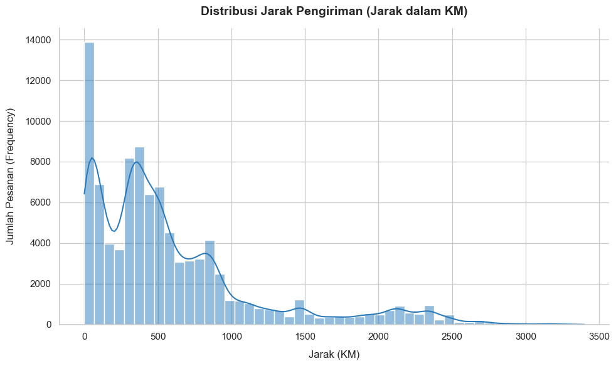
APPENDIX
Technical Footnotes & Supporting Evidence
💡 Key Insight:
Consistent with the impact of distance on customer churn, Olist's delivery distribution is highly diverse and heavily dominated by distances exceeding 100 km. Furthermore, a substantial number of transactions occur at distances greater than 1,000 km, which significantly escalates the probability of delivery delays and consequently drives a higher likelihood of churn
A5

Slide 33
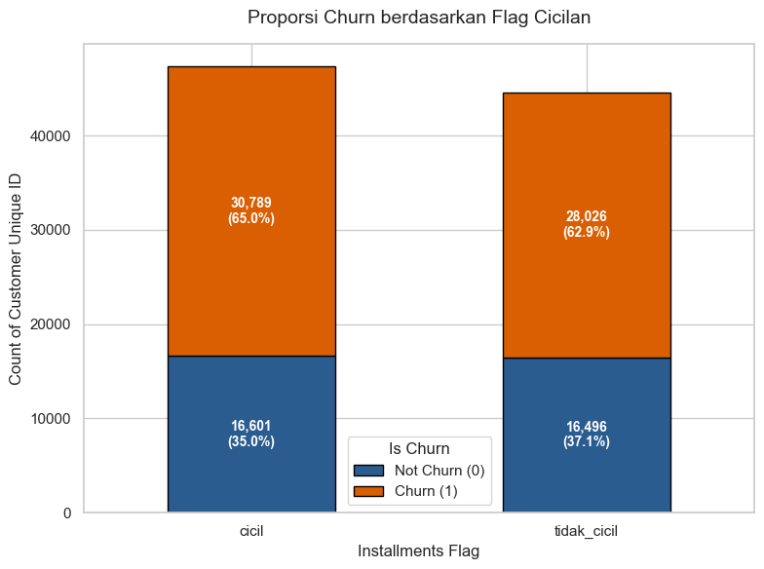
APPENDIX
Technical Footnotes & Supporting Evidence
💡 Key Insight:
Installment buyers (parcelamento) account for 52% of total revenue but represent only 38% of transactions — indicating higher average order values. Installment usage peaks in categories like Electronics and Furniture, suggesting that enabling flexible payment options is a key lever for increasing ticket size per transaction.
Installment doesn’t have any influence to the churn-risk ratio
A6

Slide 34
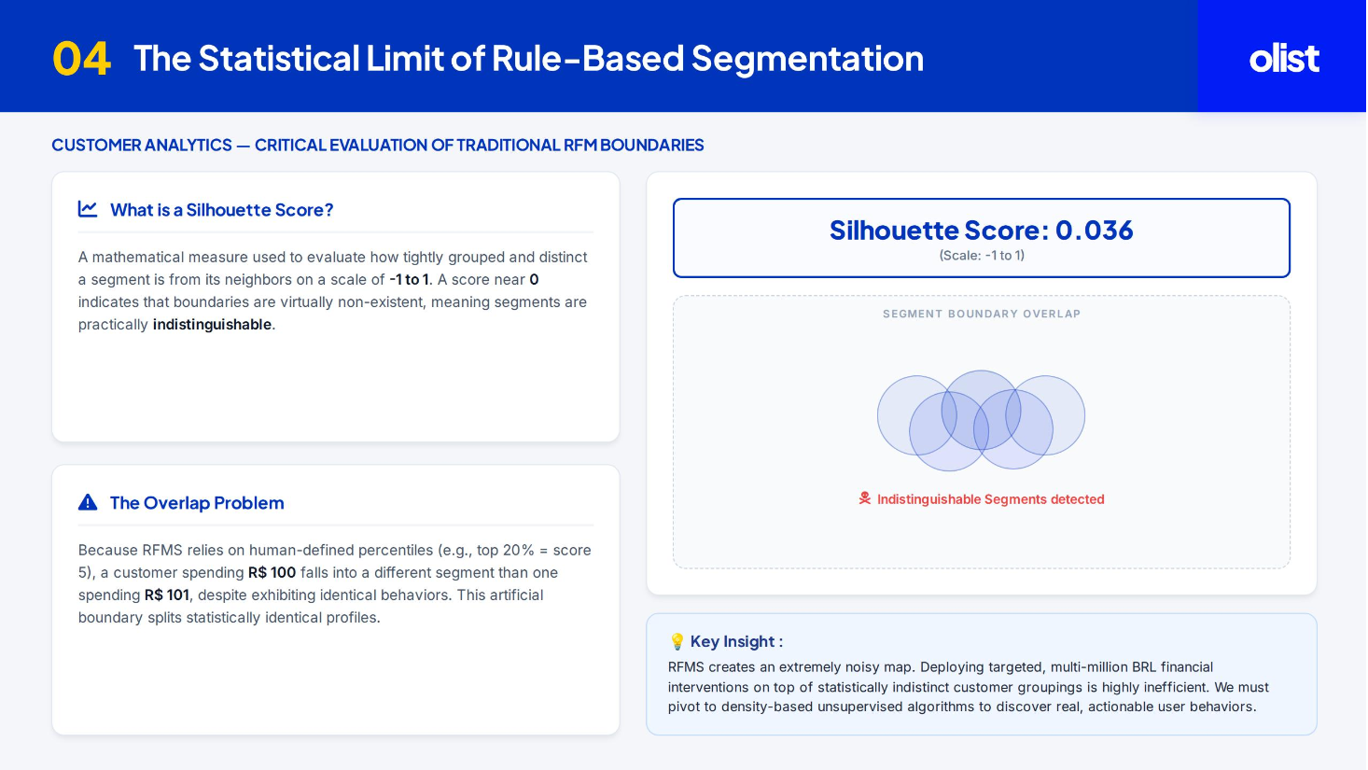
APPENDIX
Manual Customer Segmentation Silhouette Score
A7

Slide 35
APPENDIX
Technical Footnotes & Supporting Evidence
A · FULL MODEL BENCHMARK
C · EXTERNAL BENCHMARKS BEHIND THE 12% OPS UPLIFT
Method | Segments | Silhouette
RFMS (rules) | 9 | 0.036
K-Means · 5 feat | 4 | 0.472
K-Means + RF · 3 feat | 4 | 0.525
DBSCAN | 26 + noise | 0.086
McKinsey 2021 — revenue uplift → +5–15%
Bain 2023 — delivery service recovery → +5% recurring revenue
HBR · Luca 2016 — +1 rating star → +5–9% revenue via trust
B · UPLIFT SCENARIO RANGE (NOTEBOOK SIMULATION)
D · MLOPS & COST NOTES
Retraining: RF classifier monthly; K-Means re-cluster every 3–6 months (data/concept drift). Team: 1 DS + 1 MLE + 1 PM, 2–3 months ≈ R$27–43K. Frees 1–2 analysts from manual SQL segmentation.
Conservative
+2.4% · ≈ R$360K
Moderate
+4.8% · ≈ R$720K
Optimistic
+8.7% · ≈ R$1.31M
Validate uplift assumptions via regional A/B pilot before full rollout.
A8

Slide 36


APPENDIX
Evaluation Metrics
Silhouette Score
Cluster Balance & Interpretability
Refine Segmentation
PRIMARY — CLUSTER QUALITY
GUARDRAIL — BUSINESS USABILITY
VALIDATION — BETTER INTERPRETATION
Measures cohesion within and separation between segments (−1 to +1). The right yardstick when no ground-truth labels exist.
Segment sizes must support real campaigns and map to nameable personas. A high score with unusable clusters fails the business.
A Random Forest acts as a model surrogate to refine the segmentation, to understand are there features that are responsible for the differentiation.
Guards against: segments that only exist on paper (RFMS = 0.036)
Guards against: DBSCAN's 0.086 score with 26 cluster generated, which means the models are too noisy
Result: ~3 refined features
A9

Slide 37
APPENDIX
Final Cluster Centroid / Profile Table
Final persona
Customers
Cust. %
Revenue
Rev. %
Avg spend
Review
Delivery
Profile meaning
Satisfied Mass Market
69,735
76.04%
R$7.97M
52.75%
R$114.29
4.66
10.23d
Large, satisfied, low-spend base
Dissatisfied & Delayed Customers
14,709
16.04%
R$2.05M
13.58%
R$139.51
1.71
20.64d
Service-recovery target
High-Value Spenders
6,490
7.08%
R$3.68M
24.38%
R$567.60
4.30
12.84d
Premium growth segment
Whales / Top Tier VIPs
775
0.85%
R$1.40M
9.29%
R$1,811.72
3.96
14.18d
Small group, high per-customer value
Interpretation
Volume engine
Recovery target
Value leverage
Satisfied Mass Market contributes most total revenue because it dominates the customer base.
Dissatisfied & Delayed customers show the lowest review score and the longest delivery time.
High-Value + Whales represent only 7.93% of customers but 33.67% of revenue.
Core segmentation logic
Final personas are differentiated by spend, delivery speed, and satisfaction—not by frequency, because most customers buy only once.
A10

Slide 38




APPENDIX
Model Conclusion
0.525
4 personas
~100%
1 pipeline
Silhouette — 14× the RFMS baseline
from 9 fuzzy rule-based segments
RF scoring precision & recall
kmeans_pipeline.pkl, deploy-ready
Satisfied Mass Market
Dissatisfied & Delayed
High-Value Spenders
Whales / Top-Tier VIPs
76.0% cust · 52.8% rev
16.0% cust · 13.6% rev
7.1% cust · 24.4% rev
0.9% cust · 9.3% rev
R$114 avg · 4.66★ · 10.2d
R$140 avg · 1.71★ · 20.6d
R$568 avg · 4.30★ · 12.8d
R$1,812 avg · 3.96★ · 14.2d
Grow basket via bundling & repeat-purchase plays
Rescue with delivery fixes & win-back vouchers
Cross-sell premium & credit-card loyalty points
White-glove service, early access, dedicated CS
A11

Slide 39
APPENDIX
Business-Impact Formulas
Segment
Revenue base
Action assumption
Formula
Estimated impact
Dissatisfied & Delayed
≈ R$2.0M
Win back 10% buyers
R$2.0M × 10%
+R$200.0K
High-Value Spenders
≈ R$3.6M
+15% basket via premium cross-sell
R$3.6M × 15%
+R$540.0K
Satisfied Mass Market
≈ R$7.97M
+5% through welcome back package
R$7.97M × 5%
+R$398.5K
Whales / VIP
≈ R$1.404M
+12% retention
R$1.404M × 12%
+R$168.5K
Total segmentation uplift
R$15.0M baseline
Sum of segment scenarios
Σ segment impact
+R$1.31M / +8.7%
Scenario total
Controls before rollout
Observed segment revenue base: R$15.11M, estimated segmentation impact: approximately R$1.31M, scenario revenue after intervention: approximately R$16.42M, estimated uplift: 8.7%
Treat these numbers as forecast scenarios, not guaranteed results. Validate uplift through a regional A/B pilot before full national deployment.
Sensitivity scenario
Estimated uplift
Approx. revenue impact
Conservative
+2.4%
≈ R$360K
Moderate
+4.8%
≈ R$720K
Optimistic
+8.7%
≈ R$1.31M
A12

Slide 40
APPENDIX
External References & Source Notes
Data & methodology
Business benchmarks
1. Olist. Brazilian E-Commerce Public Dataset by Olist. Kaggle dataset.
2. Hosseini, S. M., Maleki, A., & Gholamian, M. R. (2010). Cluster analysis using data mining approach to develop customer profiles to change the business strategy. Expert Systems with Applications, 37(7), 5252–5259. DOI: 10.1016/j.eswa.2009.12.070.
3. MacQueen, J. (1967). Some methods for classification and analysis of multivariate observations. Proceedings of the Fifth Berkeley Symposium on Mathematical Statistics and Probability.
4. Rousseeuw, P. J. (1987). Silhouettes: A graphical aid to the interpretation and validation of cluster analysis. Journal of Computational and Applied Mathematics, 20, 53–65.
5. Ester, M., Kriegel, H. P., Sander, J., & Xu, X. (1996). A density-based algorithm for discovering clusters in large spatial databases with noise. KDD-96.
6. Pedregosa, F. et al. (2011). Scikit-learn: Machine Learning in Python. Journal of Machine Learning Research, 12, 2825–2830.
7. Luca, M. (2016). Reviews, Reputation, and Revenue: The Case of Yelp.com. Harvard Business School NOM Unit Working Paper No. 12-016. A one-star Yelp increase produced a 5–9% revenue effect among independent restaurants. Used as directional evidence only because the original setting was restaurants, not Brazilian e-commerce.
8. McKinsey & Company (2021). “The Value of Getting Personalization Right—or Wrong—is Multiplying.” Personalization most often produces a 10–15% revenue lift, with company-specific results ranging more widely. Used as directional context for targeted segment campaigns.
9. Bain & Company. Customer retention and service recovery benchmark used as directional support for retention-uplift assumptions.
10. McKinsey & Company. (2021). The Value of Getting Personalization Right—or Wrong—is Multiplying. Reports that personalization commonly drives meaningful revenue lift; used as directional support for segment-specific campaigns.
A13

